Slide 1
5 B
LOVE YOUR NEIGHBOURS

Slide 2
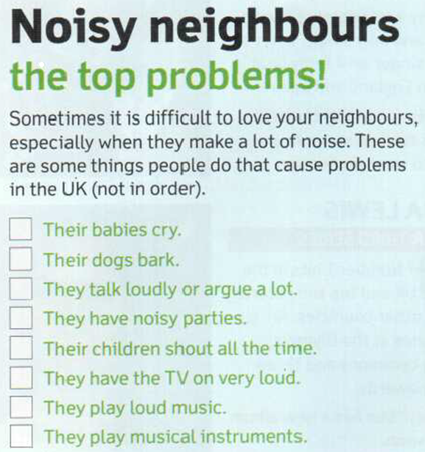

B
A
H
C
E
F
D
G

Slide 3

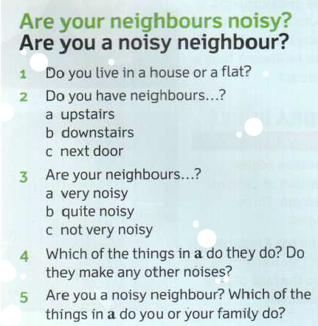

Slide 4
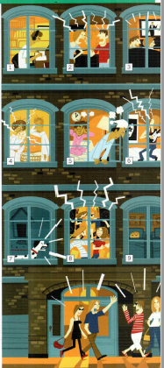
Why do you think the couple in flat 5 can’t sleep?
What is the woman in flat 1 doing?
What are the couple in flat 2 doing?
What is the couple in flat 3 doing?
What is the baby in flat 4 doing?
What is the young man in flat 6 doing?
What is the dog in flat 7 doing?
What are the people in flat 8 doing?
What are the children in flat 9 doing?
What are the people in the street doing?

Slide 5
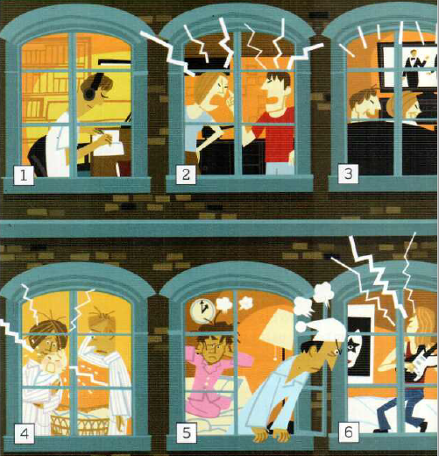
Why can’t they sleep?
What is the woman in flat 1 doing?
What are the man and the woman in flat 2 doing?
What is the couple in flat 3 doing?
What is the baby in flat 4 doing?
What is the young man in flat 6 doing?

Slide 6
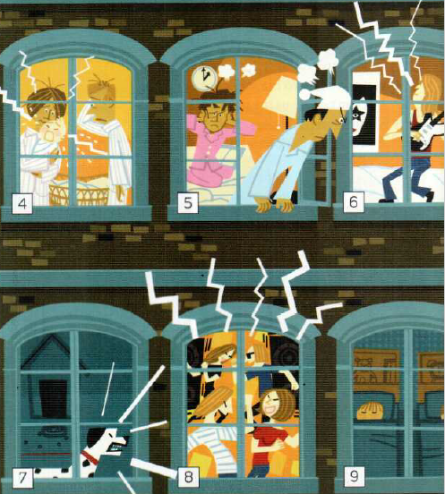
Why can’t they sleep?
What is the baby in flat 4 doing?
What is the young man in flat 6 doing?
What is the dog in flat 7 doing?
What are the people in flat 8 doing?
What are the children in flat 9 doing?

Slide 7
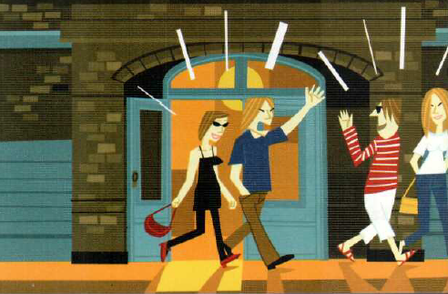
Why can’t they sleep?
What are the people in the street doing?

Slide 8
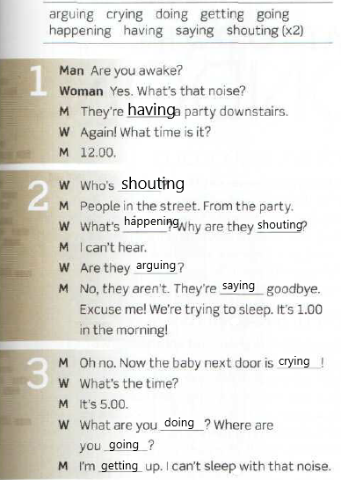
Why can’t they sleep?

Slide 9
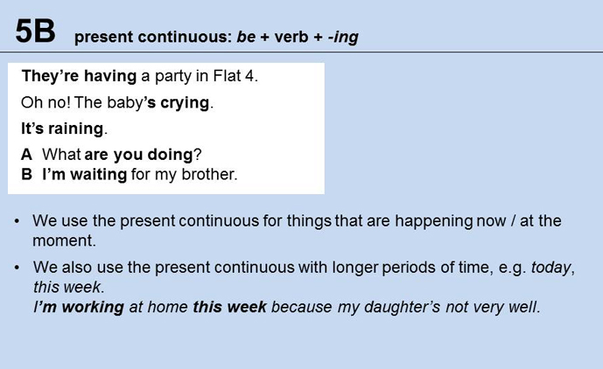

Slide 10
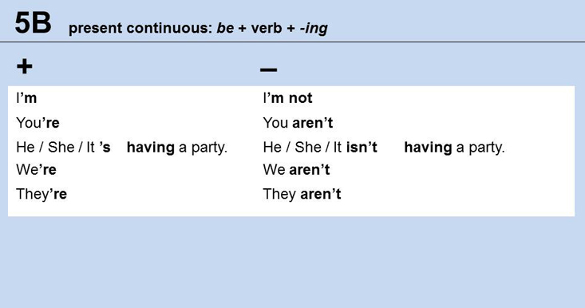

Slide 11
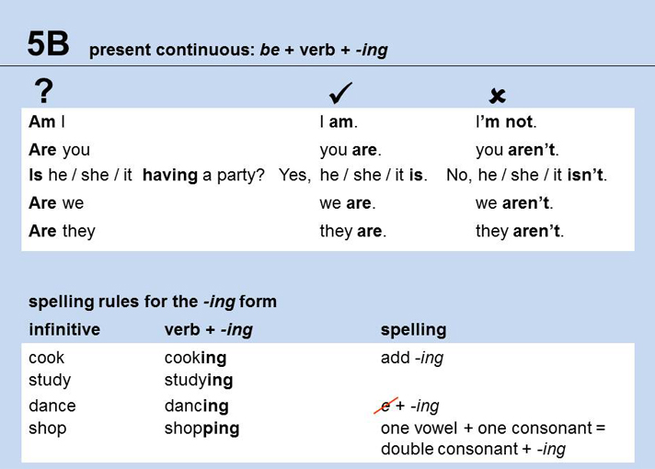
argue: arguing but agree: agreeing

Slide 12
Habits, routines, general all time things
What What | do does | you she | do? do?
What food What kind of food | do does | you he | like? prefer?
What kind of books What magazines | do does | you your friend | read? like
What TV programmes What series | do does | you your mother | watch? watch?

Slide 13
Temporary activities and situations
AT THE MOMENT / RIGHT NOW/ NOW/ THESE DAYS/ TODAY
What | are | you | doing?
What | is | she | cooking?
What book | are | they | reading?
What TV programme | is | he | watching?

Slide 14
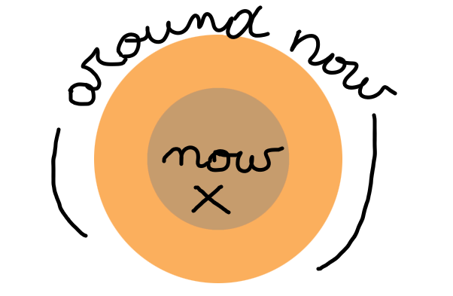
PRESENT CONTINUOUS

Slide 15
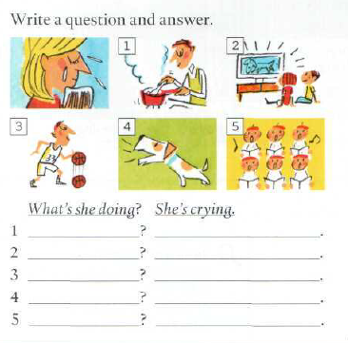
PAGE 133
What are they doing right now?
What’s he doing
He’s cooking.
What are they doing
They’re watching TV
What´s he doing
He’s playing basketball
What’s it doing
It’s barking
What are they doing?
They’re singing

Slide 16
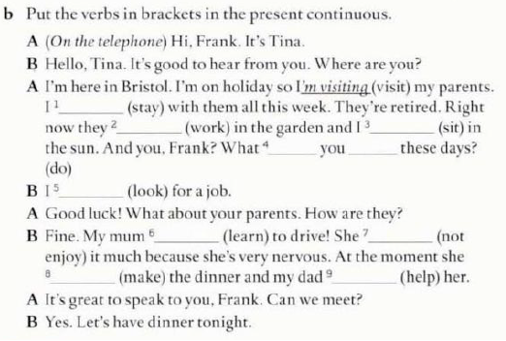
‘m staying
‘re working
‘m sitting
are
doing
‘m looking
‘s learning
isn’t enjoying
is making
is helping

Slide 17
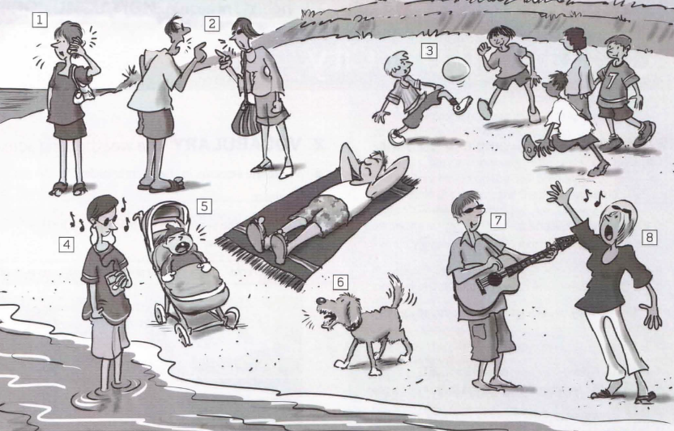
WB PAGE 33
What are they doing right now?

Slide 18
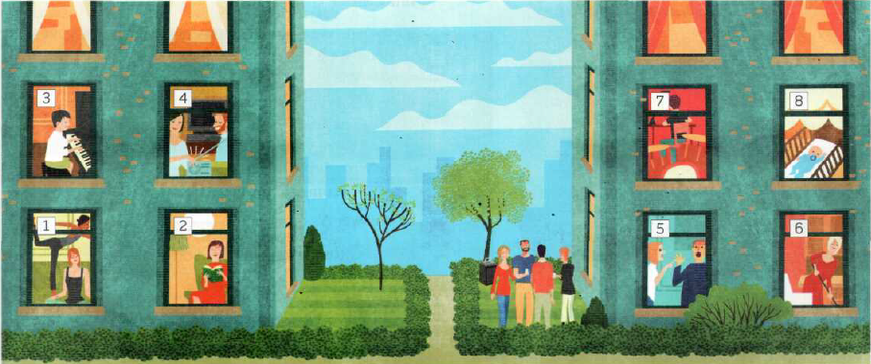
What are they doing right now?

Slide 19
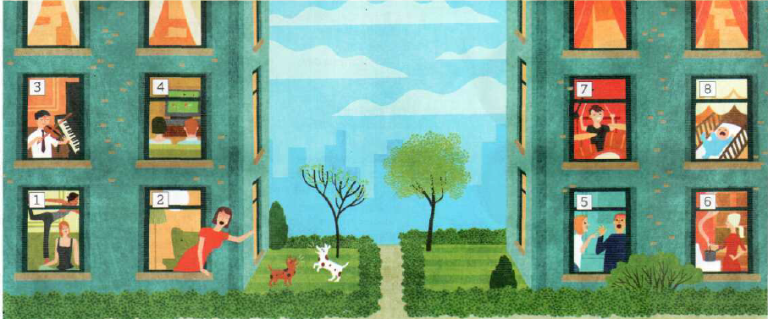
What are they doing right now?

Slide 20
What are they doing right now?
1 A person is cooking.
2 They’re playing football.
3 A man is having a shower and singing.
4 It’s raining.
5 Someone is eating spaghetti.
6 Someone is making a coffee.

Slide 21
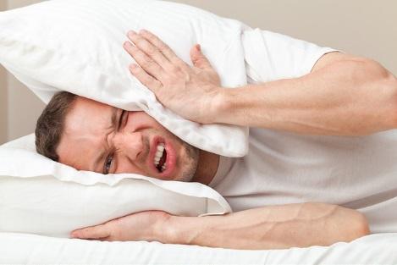
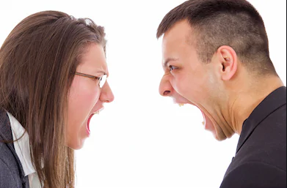

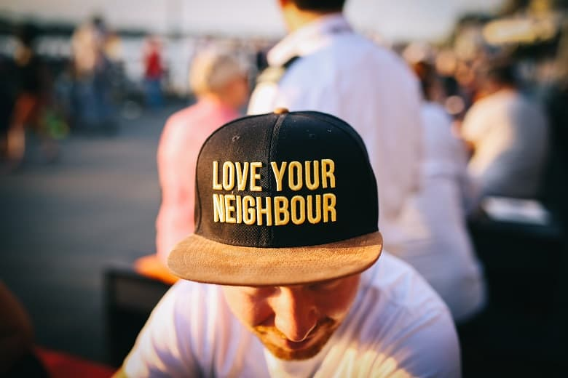

5B LOVE YOUR NEIGHBOURS

